Slide 1



COVID – 19 Project
V.S.
Drew Gilmore
James Park
Jesse King
Mike Occhicone
Nghia Nguyen

Slide 2
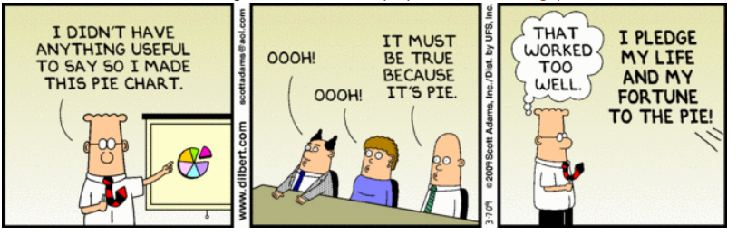
Disclaimer
This project was an exploratory analysis looking at differences between democratic and republican counties in Washington state. The intention of this project is to have fun with data visualization and data analysis and is NOT intended to make any political statements. We do NOT intend to publish this data and the findings of this study are for the sole purpose of a class project.
Notes:
Questions:
Do certain counties, by political affiliation, have higher rates of covid cases, hospitalizations and deaths?
Are older patients more likely to be infected with COVID-19 and have worst clinical outcomes?
Are certain factors associated with higher rates of covid infections and worst outcomes:
Income
Poverty level
Population density

Slide 3
Project Summary
Purpose: Analyze Covid-19 data from Washington State to understand the relationship between political affiliation, income, poverty and age with Covid-19 outcomes.
Hypotheses:
H_{1A}: Washington counties grouped by political affiliation will show a significant difference
in Covid-19 outcomes (cases, hospitalizations, and deaths).
H_{2A}: Mean household income will negatively correlate to Covid-19 outcomes (cases,
hospitalizations, and deaths).
H_{3A}: Poverty rate will positively correlate to Covid-19 outcomes (cases, hospitalizations,
and deaths).
Notes:
Define the core message or hypothesis of your project.
Describe the questions you asked, and why you asked them
We were interested in looking at 3 variables that have not been widely discussed (income status, poverty rate, and political affiliation) and 1 variable that has been widely related to (age) Covid-19 outcomes.
We chose Washington State in order to limit the scope of our project and because……
Describe whether you were able to answer these questions to your satisfaction, and briefly summarize your findings
Our analysis found significant differences for all three hypotheses. However, the relationship between income and Covid-19 outcomes was in the opposite direction than what we expected. We will discuss later our theory for why that was the case.

Slide 4
Data Sets - Flow Chart
Data sets were made by combining and modifying from multiple sources.
Cases Data
Group by Month
Death Data
Merged Data
Politics + Income Data
Final Data
Hospitalization Data
Pop. Density
Source: Census, CDC & usa.com
Notes:
Questions & Data
Elaborate on the questions you asked, describing what kinds of data you needed to answer them, and where you found it

Slide 5
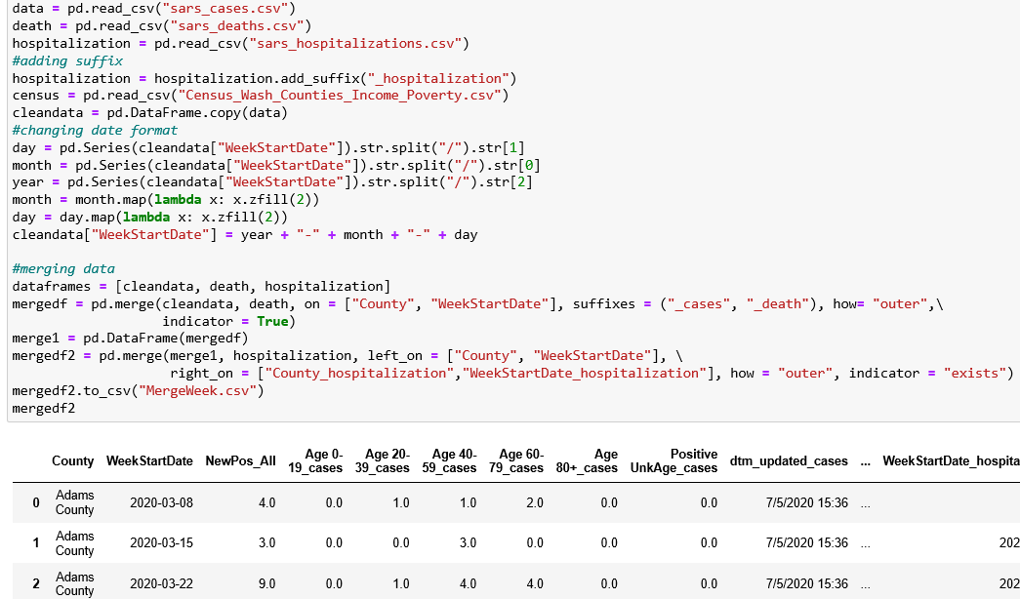
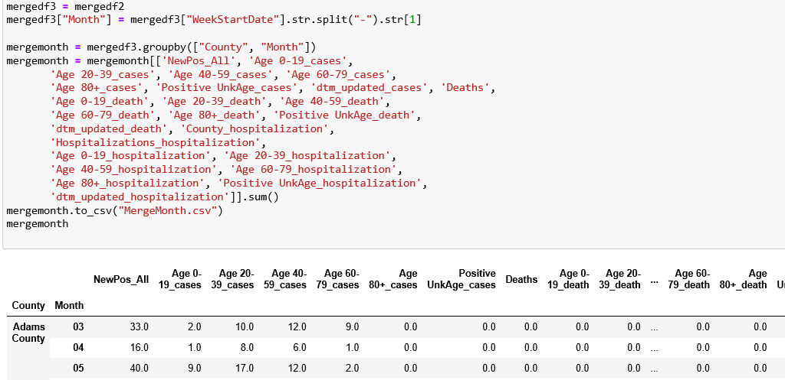
Data Sets - Jupyter Notebook
Merging Data
Cleaning Data
Notes:
Data Cleanup & Exploration
Describe the exploration and cleanup process
Discuss insights you had while exploring the data that you didn't anticipate
Discuss any problems that arose after exploring the data, and how you resolved them
Present and discuss interesting figures developed during exploration, ideally with the help of Jupyter Notebook

Slide 6
Baseline characteristics of Washington state

Slide 7
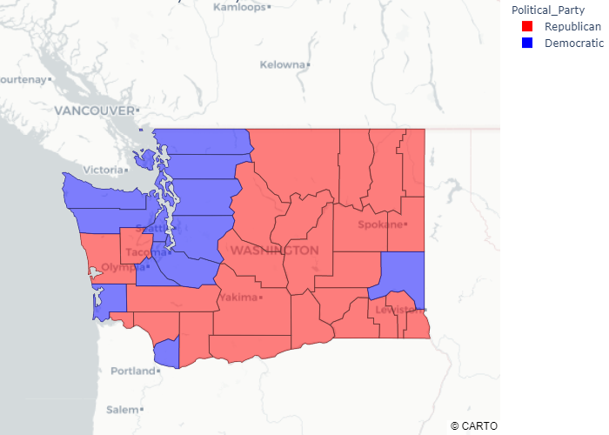
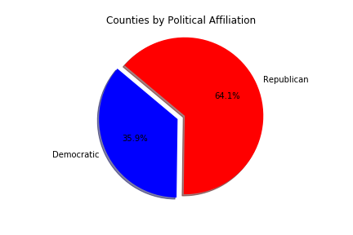
Political Affiliation of Washington
14 democratic counties, 5.7 million people (75%)
25 republican counties, 1.9 million people (25%)
Notes:
14 democratic counties
25 republican counties

Slide 8
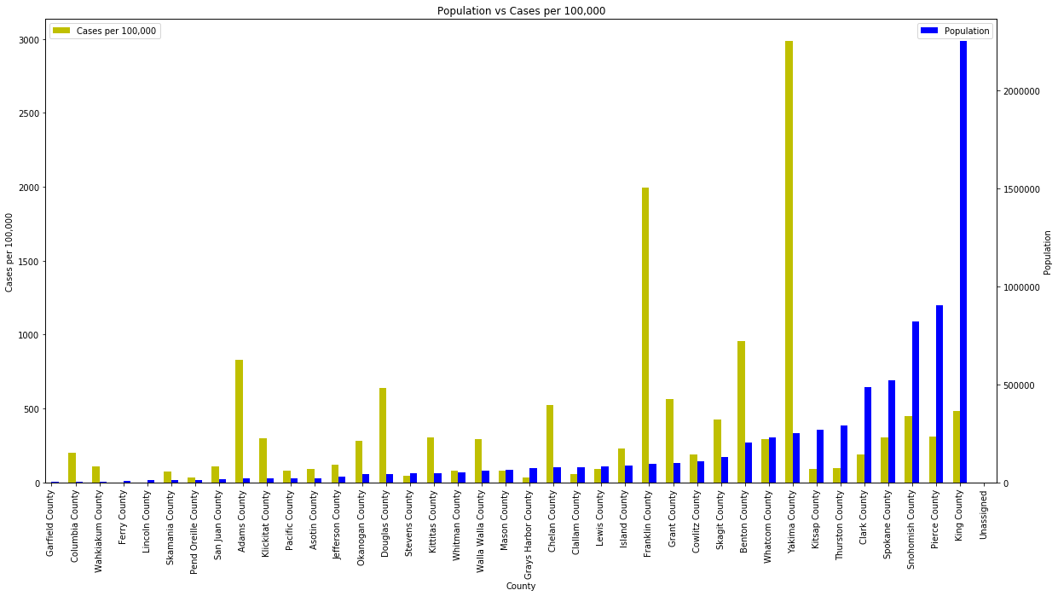
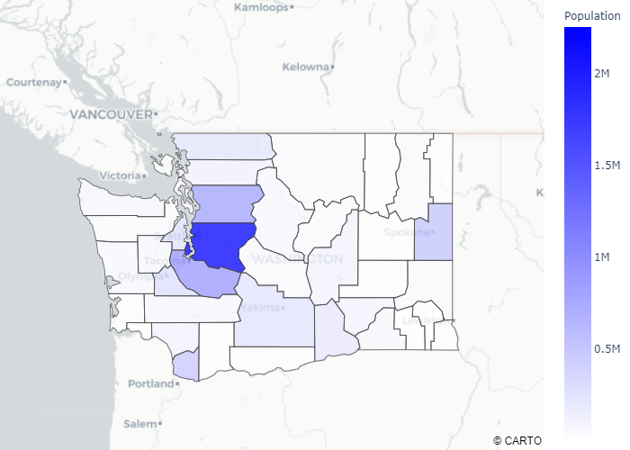
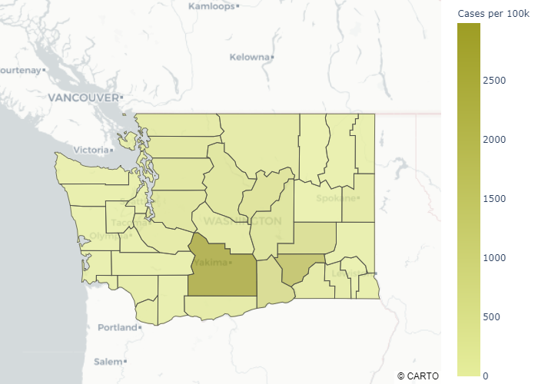
Overview of Washington

Slide 9
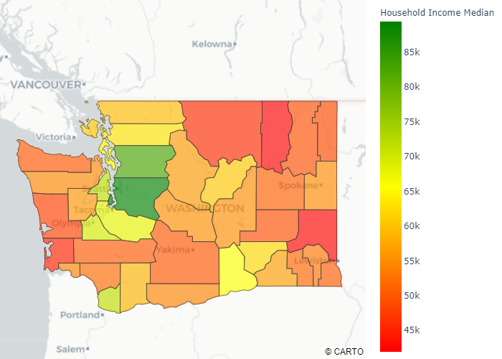
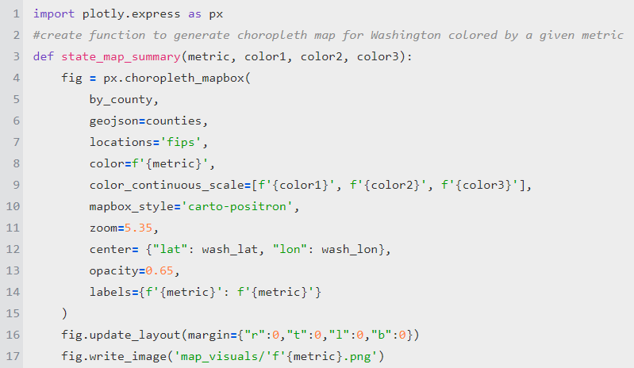
Overview - Poverty & Income

Slide 10
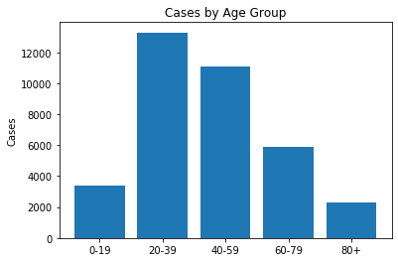
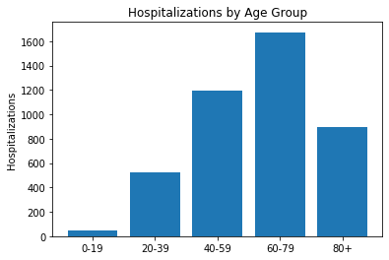
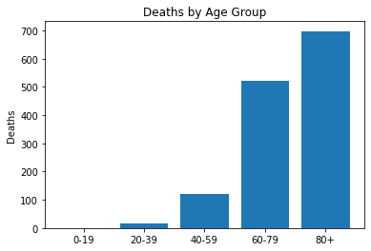
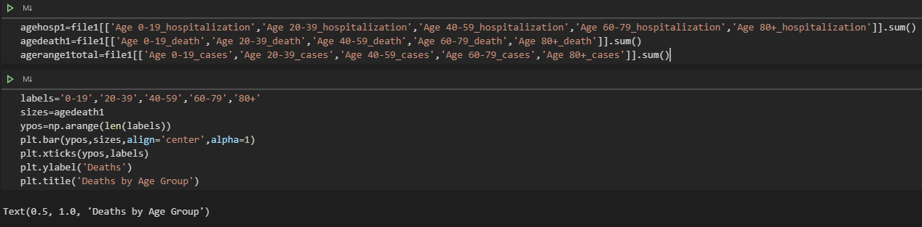
Overview – Age (counts)

Slide 11
Analysis/Results

Slide 12
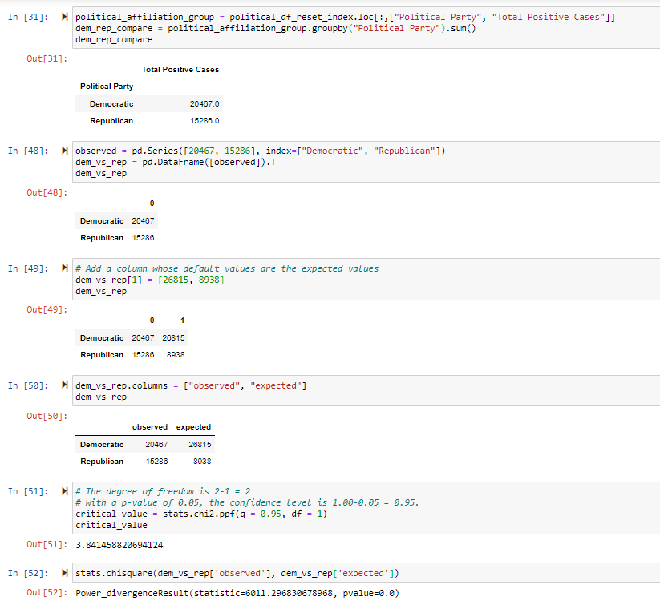
Analysis – Political affiliation
Republican Counties:
16% positive cases
Democratic counties: 7% positive cases
p-value: <0.01
We reject the null hypothesis that there is NOT a difference in positive cases in republican counties compared to democratic counties.
We accept the alternative hypothesis that there IS a difference in positive cases in republican counties compared to democratic counties

Slide 13
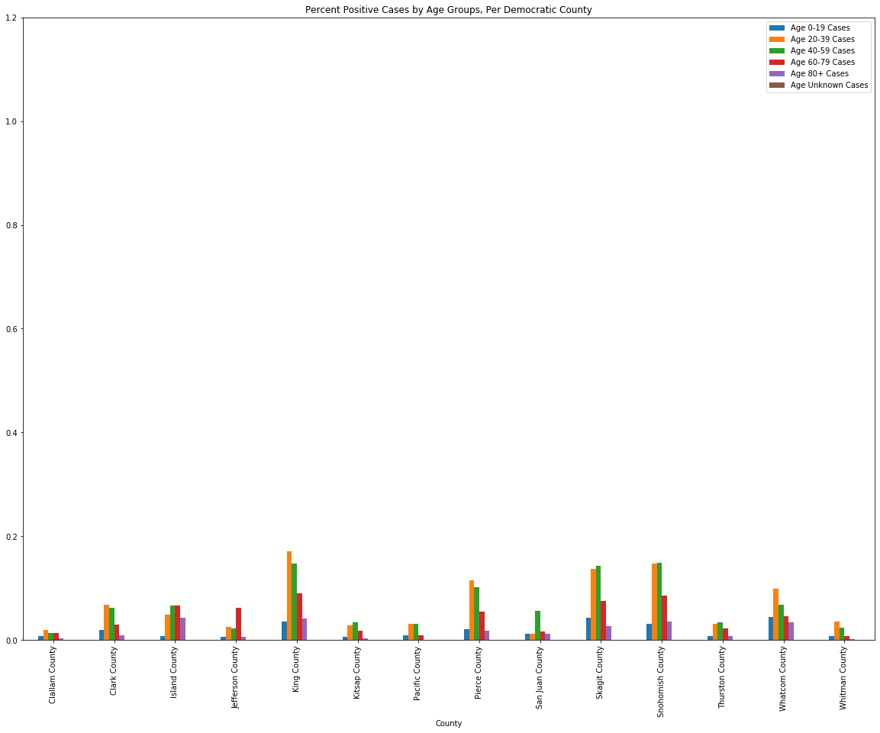
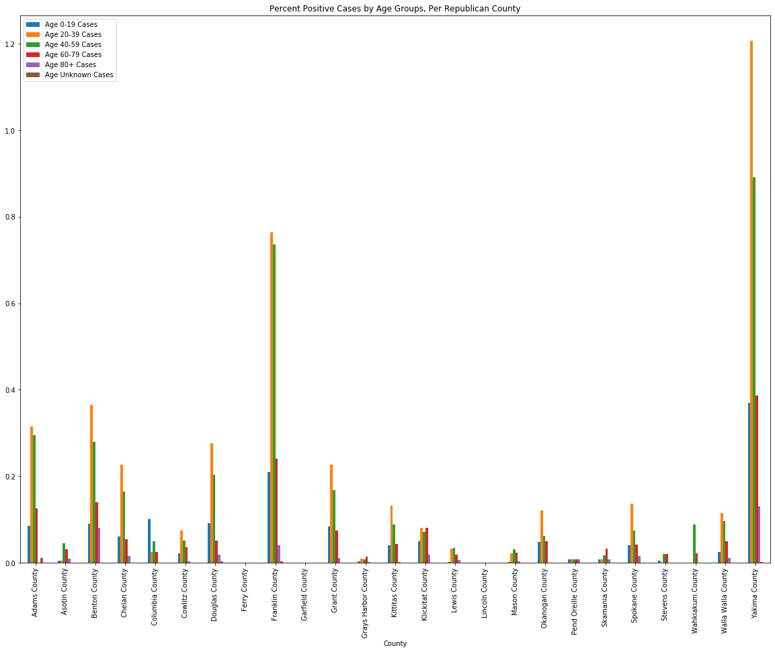
Analysis – Age by Political Affiliation
Democrat
Republican

Slide 14
Data Analysis:
Income, Poverty, and Covid-19 Outcomes
H_{2A}: Mean household income will negatively correlate to Covid-19 outcomes (cases,
hospitalizations, and deaths).
H_{3A}: Poverty rate will positively correlate to Covid-19 outcomes (cases, hospitalizations,
and deaths).
Notes:
This should include a heading for each “question” you asked of your data and a short description of your findings and any relevant plots
Data Analysis
Discuss the steps you took to analyze the data and answer each question you asked in your proposal
Present and discuss interesting figures developed during analysis, ideally with the help of Jupyter Notebook
Discussion
Discuss your findings. Did you find what you expected to find? If not, why not? What inferences or general conclusions can you draw from your analysis?

Slide 15
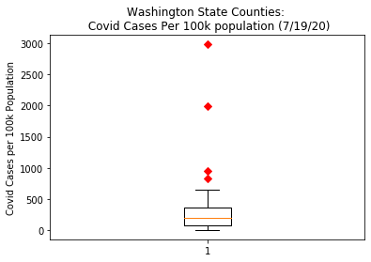
Data Analysis:
Income, Poverty, and Covid-19 Outcomes
Outlier | Cases Per 100k pop.
Yakima County* | 2985.18
Franklin County* | 1993.24
Benton County* | 957.0
Adams County | 830.7

Slide 16
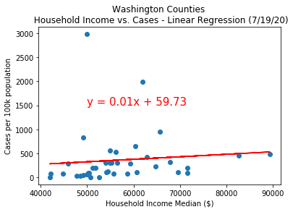
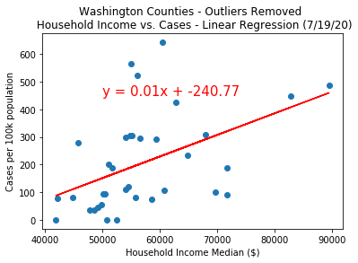
Data Analysis:
Income and Covid-19 Outcomes
 | Outliers Included | Outliers Removed
p value | .56 ns. | .004*
R | .1 | .47
R Squared | .01 | .22

Slide 17
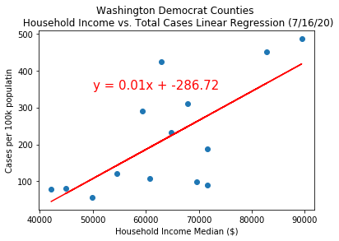
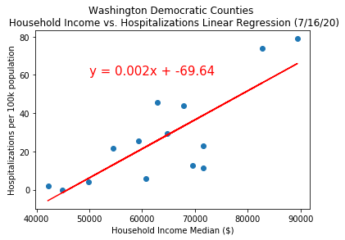
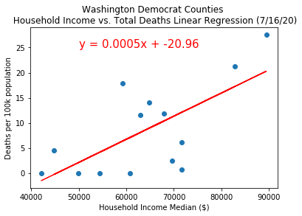
Data Analysis:
Income and Covid-19 Outcomes
 | Cases | Hosp. | Deaths
p value | .006* | .001* | .008*
R | .69 | .8 | .68
R Squared | .48 | .64 | .46

Slide 18
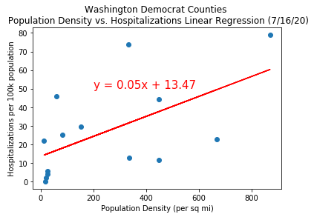
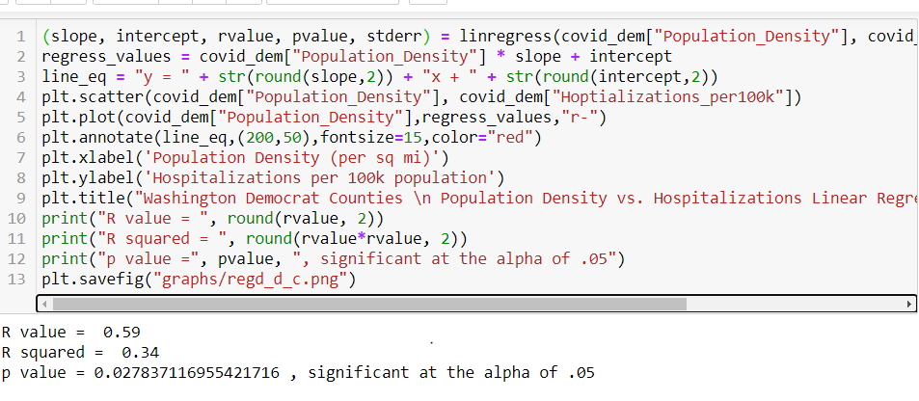
Data Analysis:
Population Density and Covid-19 Outcomes
p value | .028*
R | .59
R Squared | .34

Slide 19
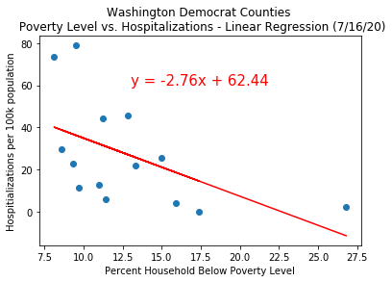
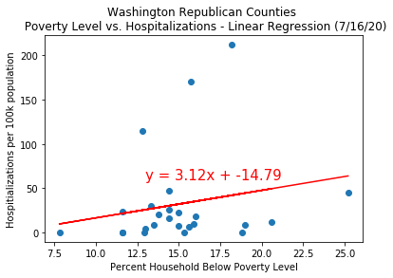
Data Analysis:
Poverty and Covid-19 Outcomes
 | Dem. Counties | Rep. Counties
p value | .049* | .338 ns.
R | -.53 | .2
R Squared | .28 | .04

Slide 20
Conclusions:
Income, Poverty, and Covid-19 Outcomes
H_{2A}: Mean household income will negatively correlate to Covid-19 outcomes (cases,
hospitalizations, and deaths). - rejected, effect occurred in the opposite direction.
H_{3A}: Poverty rate will positively correlate to Covid-19 outcomes (cases, hospitalizations,
and deaths). rejected, effect occurred in the opposite direction for democratic
leaning counties.
Population density is a potential confounding variable.
Notes:
Data and analysis does not support our hypotheses; we found significance in the opposite direction of what we expected. In that higher income areas have significantly higher rates of Covid outcomes. Population density is a potential confounding variable.
For poverty levels in democrat leaning counties higher rates of poverty are significant linked to lower covid outcomes. In republican leaning counties there was no significant correlation.

Slide 21
Lessons Learned
Difficulties that arose:
Merging with Git repository
Obtaining political affiliations
Ensuring accurate accounting of cases
If we had two more weeks:
Subgroup analyses:
gender
total tests completed
household number
deeper analysis on swing states
More detail overall
Notes:
Discuss any difficulties that arose, and how you dealt with them
Discuss any additional questions that came up, but which you didn't have time to answer:
What would you research next, if you had two more weeks?

Slide 22

Q & A

Slide 23

The End

Slide 24
Data Analysis/Conclusion
This should include a heading for each “question” you asked of your data and a short description of your findings and any relevant plots
Data Analysis
Discuss the steps you took to analyze the data and answer each question you asked in your proposal
Present and discuss interesting figures developed during analysis, ideally with the help of Jupyter Notebook
Discussion
Discuss your findings. Did you find what you expected to find? If not, why not? What inferences or general conclusions can you draw from your analysis?

Slide 25
Density
Figure from Mike

Slide 26
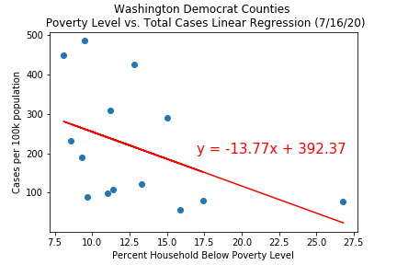
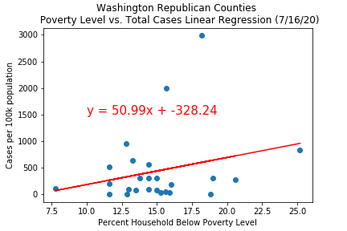
Analysis - Poverty & Income
Democrat
Republican

Slide 27
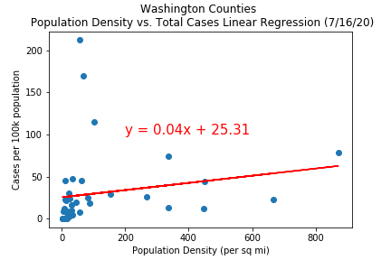
Mike – Population Density

Slide 28
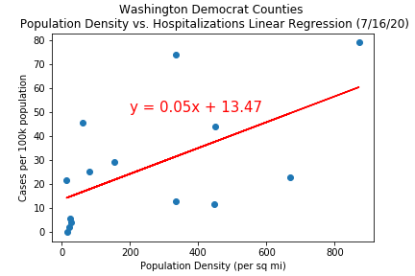
Mike – Democrat. Population Density

Slide 29
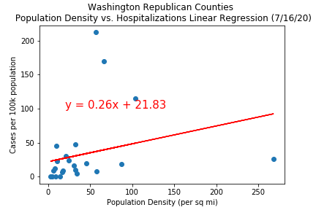
Mike – Repub. Population Density

Slide 30
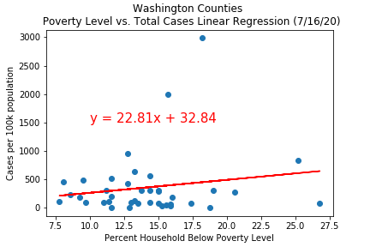
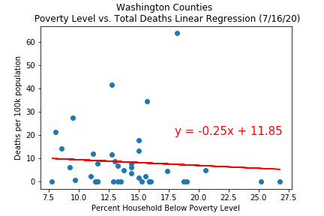
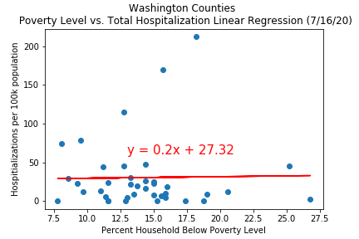
Mike – Poverty Level

Slide 31
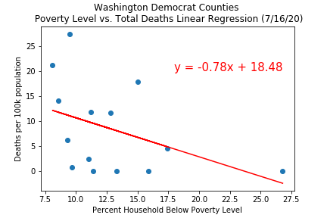
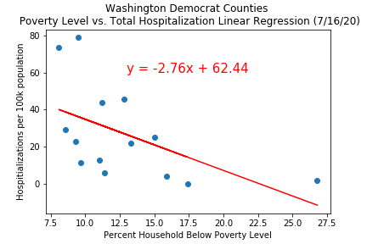
Mike – Democrat Poverty Level

Slide 32
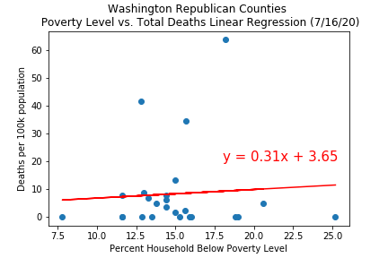
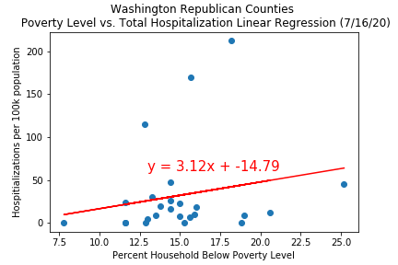
Mike – Repub Poverty Level

Slide 33
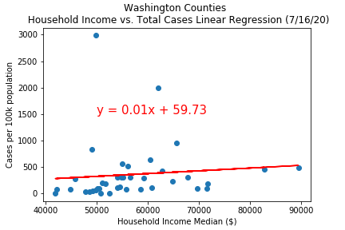
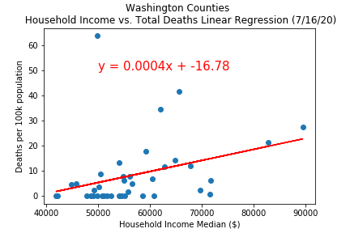
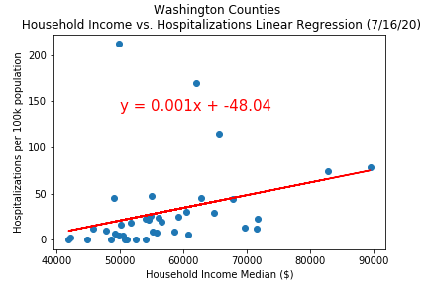
Mike – Household income

Slide 34
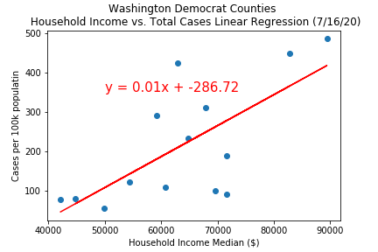
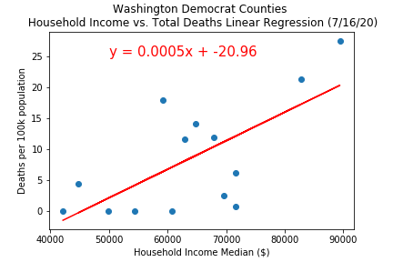
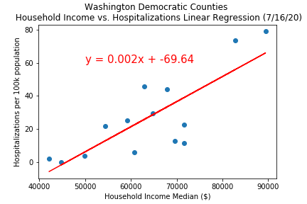
Mike – Democrat Household income

Slide 35
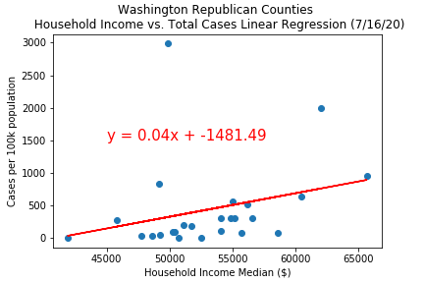
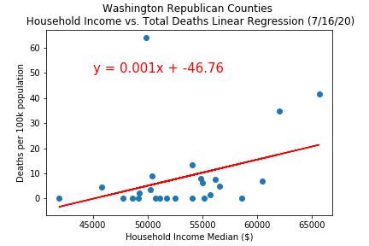
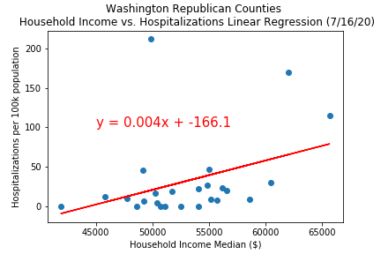
Mike – Repub Household income

Slide 36
Jesse - age

Slide 37
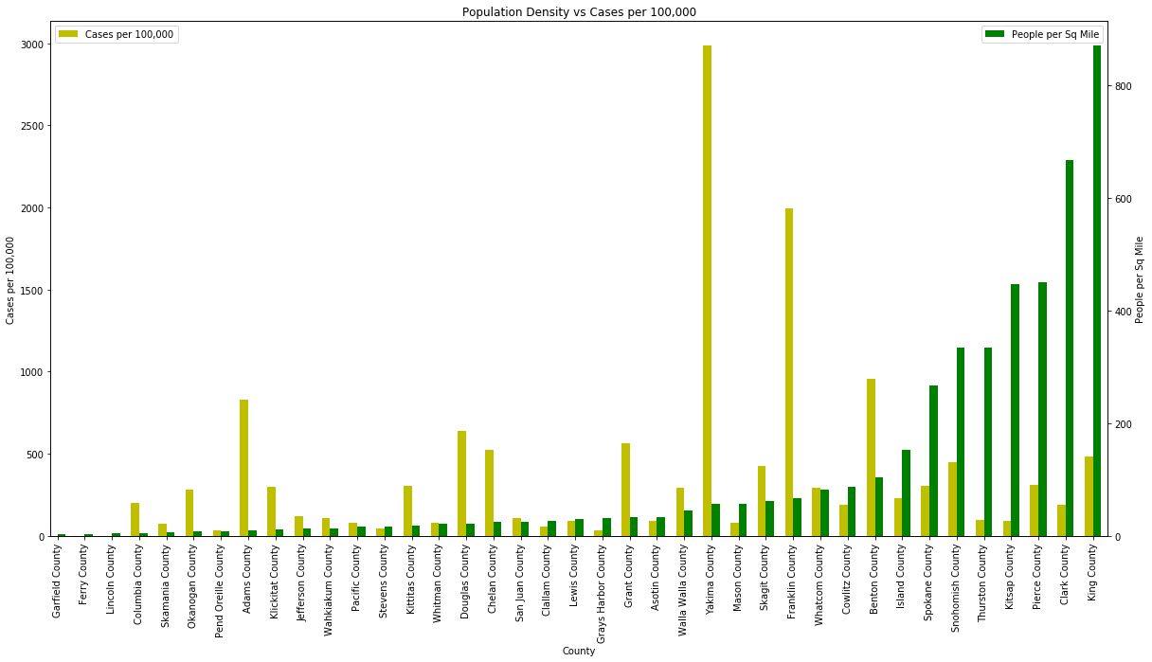
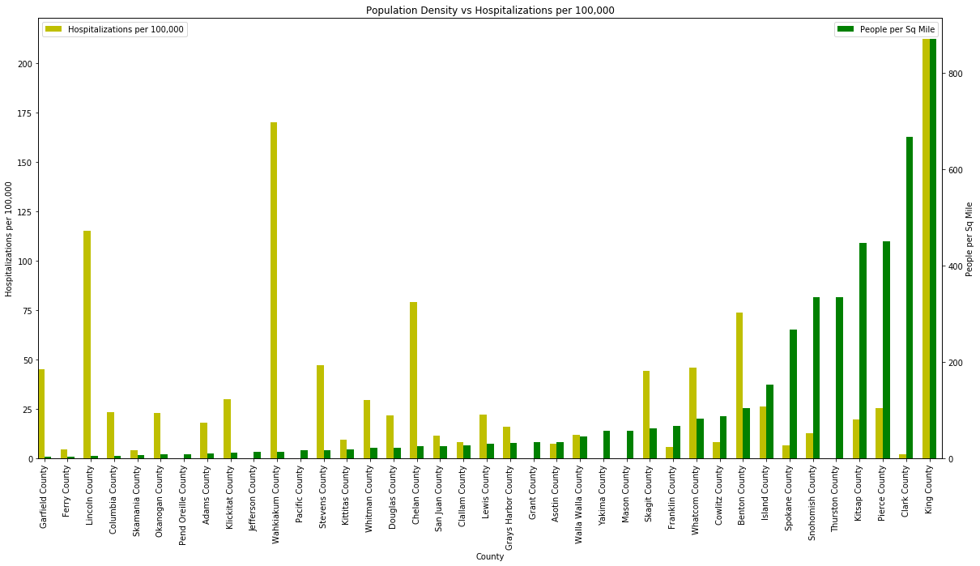

Jesse - Density

Slide 38


Jesse - Population

Slide 39


Jesse – Hosp. vs death

Slide 40
Nghia – pos cases by age

Slide 41


Nghia – Income

Slide 42


Nghia - Population

